Slide 1
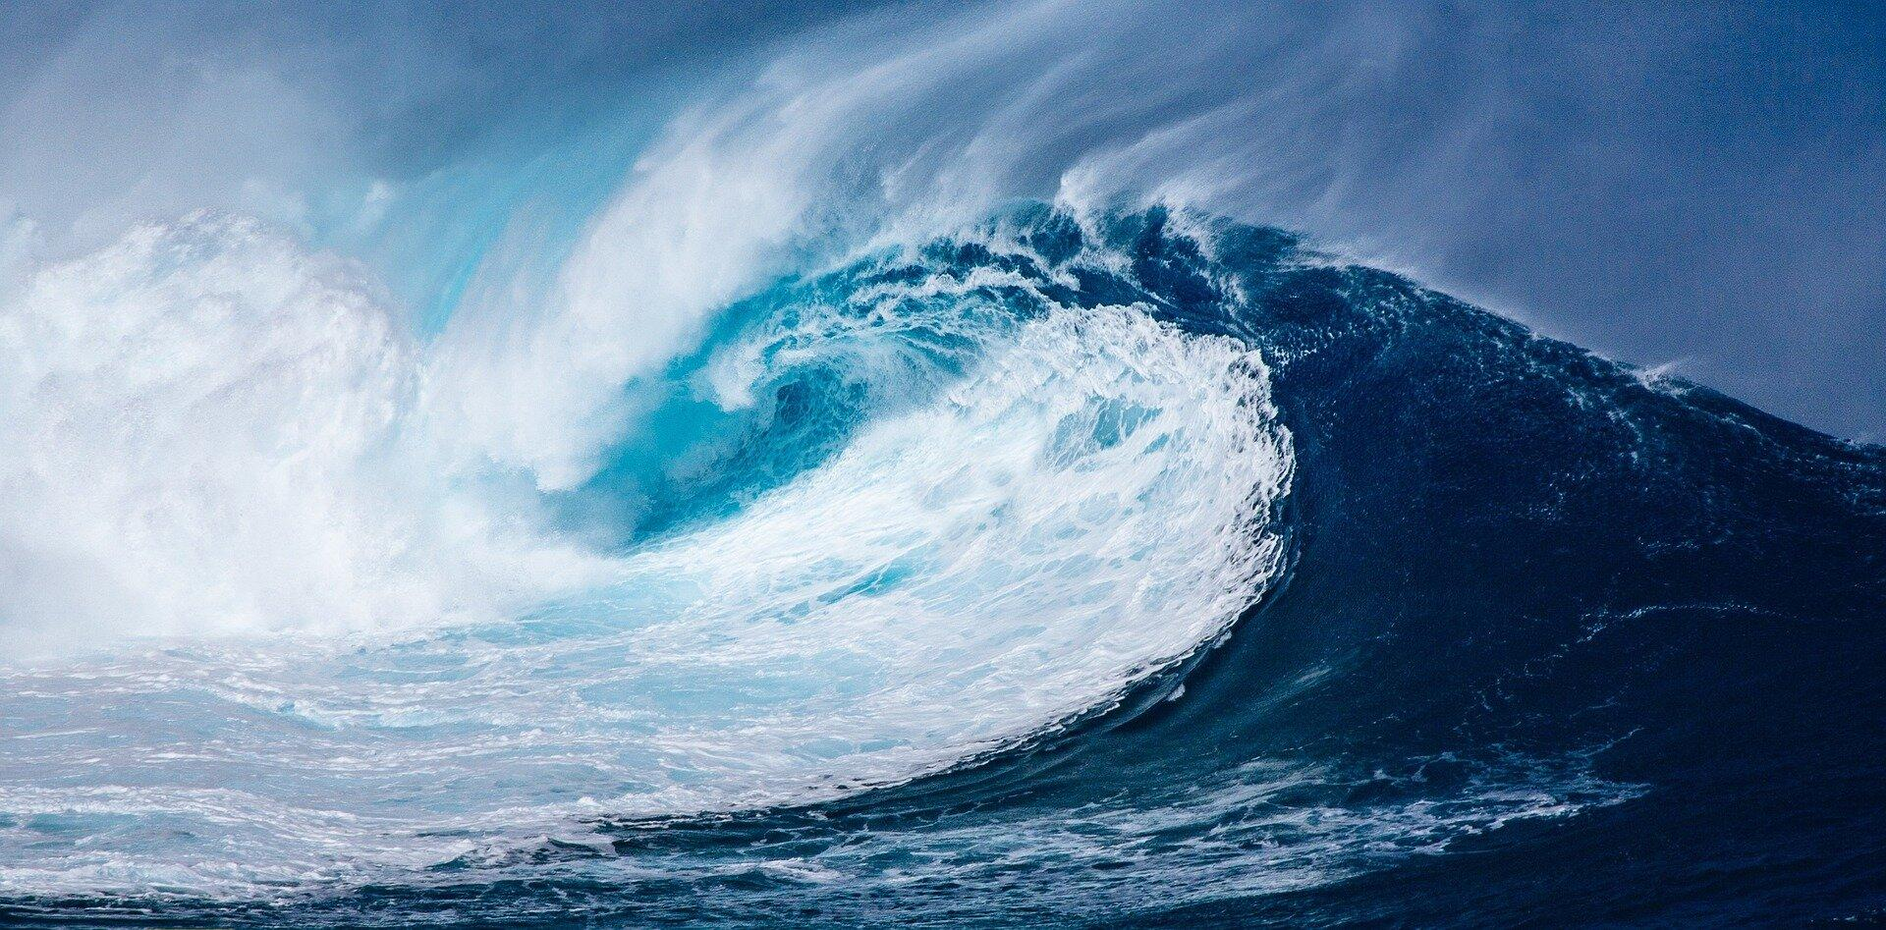
Let’s do the WAVE!
Presented by - Julie Rhea
Bland Middle School 7-8
2194 FM 36
Celeste, TX 74985
www.julie.rhea@blandisd.org
www.rheazclass.com

Slide 2
Teaching Objectives:
Students will gain a better understanding of waves (transverse and longitudinal), the vocabulary that will be used in this unit, light and the electromagnetic spectrum and how we use them.
Students will learn patterns and characteristics of waves that can be observed within the natural world.
Students will create models of waves to gain a better understanding of the natural world.

Slide 3
Applicable 2024 TEKS:
5.8C - Demonstrate that light travels in a straight line until it strikes an opaque object and is reflected, refracted or absorbed.
6.8C – Explain how energy is transferred through transverse and longitudinal waves.
8.8A - Compare the characteristics of amplitude, frequency, and wavelength in transverse waves, including the electromagnetic spectrum.
8.8B – Explain the use of electromagnetic waves in applications such as radiation therapy, wireless technologies, fiber optics, microwaves, ultraviolet steralization, astronomical observations, and x-rays.
Why they need a solid grasp of these TEKS:
Phys 8.B – Compare the characteristics of transverse and longitudinal waves, including the electromagnetic and sound waves.
Phys 8.C – Investigate and analyze characteristics of waves, including velocity, frequency, amplitude, and wavelength, etc.
Phys 8.E – Compare the different applications of the electromagnetic spectrum, including radio telescopes, microwaves, and x-rays.

Slide 4


Looking at Light
While we’re getting started, if you’d like, use the QR code at the top to get your own copy of the notes for this presentation.
CAST WiFi password
STATCAST25

Slide 5
Vocabulary for this Unit *
While the vocabulary is extensive, it’s usually picked up fairly quickly as you do the hands-on labs. The one I have attached is what I use for middle school 7-8.
But the biggest question is WHAT’S A WAVE?
To understand this, we have to remember that ENERGY is the ability to do work or cause CHANGE.
Anytime there’s a disturbance that transfers ENERGY from one place to another (remember – it’s ENERGY on the move – NOT matter), it typically moves through a medium (like air or water) in a pattern. Common examples include water waves, sound waves, light waves, and even seismic waves during earthquakes. Some waves, however, can travel even WITHOUT a medium (like all wavelengths along the electromagnetic spectrum.)
* I’ve hyperlinked the title with the vocabulary list I give my students prior to the unit. It has Spanish translations attached. They’re the handouts I have here if you need one, or you can email me for a copy.
Notes:
Notes: Electric current is the movement of an electric charge through a conductor. For example, an electric charge carried by electrons through a wire. An electromagnetic wave does not require a conductor. Electromagnetic waves are created by moving electric charges, but once created, they can propagate through a vacuum.

Slide 6
How does light travel?
5.8C - Demonstrate that light travels in a straight line until it strikes an opaque object and is reflected, refracted or absorbed.
With a pinch of corn starch or talcum powder and a laser pointer, students can see the path of light it travels.
Discuss that although the photons travel in straight lines called rays from origin or source (sun, light bulbs) to opaque objects, it is also an electromagnetic WAVE that can be measured by the distance from one wave top or "crest" to the next. That distance also determines the color of the light. Demonstrate these waves (high energy, short waves and low energy longer waves) with a slinky and differentiate from pulse (like sound or electricity.)
There are plenty of fun reflection/refraction activities using water, straws, flashlights and mirrors.

Slide 7

Now you see me, now you don’t.
5.8C - Students will demonstrate and explain how light travels in a straight line and can be reflected, refracted or absorbed.
While there are tons of resources for reflection & refraction, today we’ll focus on absorption as it ties to the EM spectrum… more specifically, visible light! Objects look different and appear different colors because they absorb some wavelengths of light (certain colors) and reflect other colors.
The color you see on an object depends on the light frequencies / wavelengths that reach your eye. If a surface absorbs all of the colors but red, then it reflects red, and that’s the color we see.
Use a page with various colored tiles and ask students what colors they see when observed under differently colored lights.
Notes:
www.sciencelearn.org
Video link to https://www.youtube.com/watch?v=O0PawPSdk28&authuser=0

Slide 8
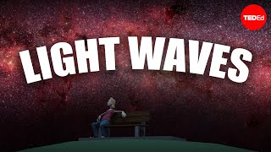
Using battery-operated lights in an empty paper box, you can ask the students to determine actual colors to demonstrate reflection and absorption.
Notes:
www.sciencelearn.org
Video link to https://www.youtube.com/watch?v=O0PawPSdk28&authuser=0

Slide 9
Waves 101
6.8C – Explain how energy is transferred through transverse and longitudinal waves.
8.8A - Compare the characteristics of amplitude, frequency, and wavelength in transverse waves, including the electromagnetic spectrum.
When energy is transferred, the excited particles of the medium cause movement (a WAVE) in a direction that is either PARALLEL (longitudinal) or PERPENDICULAR (transverse) to the direction of the wave’s travel.
When there is NO medium, energy can still travel in the form of electromagnetic waves. These waves, like light and radio waves, can travel through the vacuum of space, meaning they don’t need a medium to propagate or disperse.

Slide 10

Types of Waves
Waves 101
Mechanical
Electromagnetic
Both
* Requires a medium to travel (like air for sound, water or ground
for ocean or seismic waves)
* Travels at the speed of light!
Transport ENERGY
- NOT matter
Move away
from a source
Caused by vibrations or disturbances
Have amplitude, wavelength & frequency
Can be
transverse
Can travel through the vacuum
of space with no medium
Speed depends on the medium (temperature, density and elasticity)
* ALWAYS a Transverse Wave!
Can be a Longitudinal
(Compression Wave like sound) OR a Transverse Wave (ripples on a pond or waves on a guitar string)
* Has Crests and Troughs
Includes all forms of radiation (like visible light
X-rays, microwaves, radio
waves, ultraviolet, etc.
* Will have areas of Compression and Rarefaction or Expansion (ONLY true for Longitudinal waves)
Comes from disturbances in
the electric & magnetic fields

Slide 11
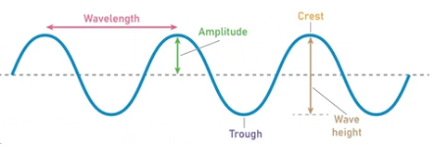

Longitudinal
Transverse and Longitudinal Waves
Transverse
Wavelength
These are anything from ripples on the surface of water, the wave in a crowded stadium, to any of the categories within the electromagnetic spectrum (like visible light waves, radio waves, microwaves, x-rays, etc.) Although guitar strings vibrate, sound waves are not transverse waves because their oscillations are parallel to the direction of the energy movement.
In a longitudinal wave, particles of the medium move energy back and forth in the same direction the wave is traveling (parallel) which is unlike transverse waves where particles move up and down, perpendicular to the wave direction that energy travels. You’ll see these with medical ultrasounds, compressed springs and sound waves. *
Notes:
You can model these with an aluminum rod and some rosin using simple parallel strokes.
Don’t forget to stress the vocab. when reviewing these – wavelength, amplitude, crest, trough, frequency, rarefaction, compression, etc.
Graph Maker at Ophysics allows you to make FREE transverse or longitudinal graphs for your tests, exit tickets, and worksheets. https://ophysics.com/t3.html

Slide 12
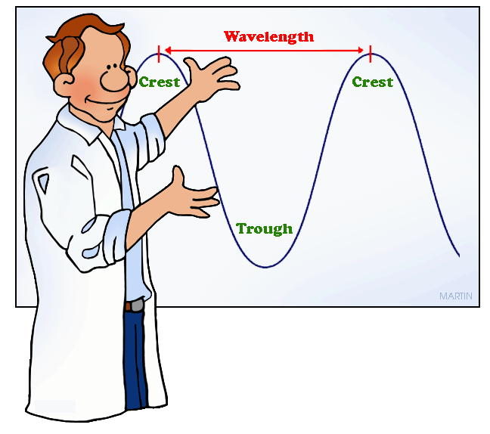
Transverse and Longitudinal Waves
While modeling with a coil or slinky, have the students experiment with…
Frequency
Amplitude
Wavelength
Speed
and make CONNECTIONS! It’s an inverse relationship that students should be able to understand. As the frequency of a wave increases, the wavelength decreases, and vice versa. This is due to the constant wave speed which is the product of frequency and wavelength. Also, the energy of the wave is directly proportional to its frequency, so waves with higher frequency will have more energy.
Let’s try it!
Notes:
Frequency = 1 per 10 sec. vs. 1 per sec. = how often it occurs When they do this, ask about how high each wave went?, how far between peaks?, what was the speed of the wave? Which had more energy?
Amplitude = Higher or lower = height of the wave
Wavelength = distance from top of crest to top of crest or trough to trough
Speed = measured in Hz - give them the formula and some BASIC/EASY steps.
Demonstrate with ropes, slinky toys or plastic or metal tubing - see resources for Educational Innovations.

Slide 13
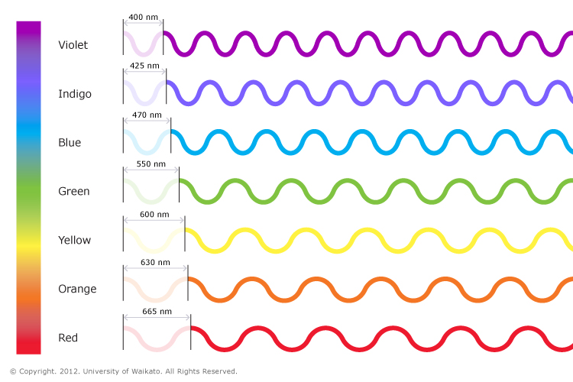
Transverse and Longitudinal Waves
6.8C – Explain how energy is transferred through transverse and longitudinal waves.
Let’s model the difference between longitudinal and transverse waves.
Low budget classroom? No problem. Have the kids stand in a circle holding hands keeping them at the waist. They’ll pass along a gentle squeeze through the whole circle. (That’s Longitudinal as the “disturbance” travels parallel to the “medium” of their hands.) If they increase the pressure A BIT (stress this please) that is a compression with increased energy.
For Transverse, start “the wave” as done in stadiums worldwide with hands joined. Experiment with frequency, amplitude and the amount of energy.
Let’s make some connections!
Notes:
Demo – hands to differentiate between longitudinal and transverse – Longitudinal all holding hands at hip level and squeeze travels like the game “telephone” from one side to other. THAT’S longitudinal – energy traveling PARALLEL to the resting position. If they do the wave as done in football stadiums (everyone taking turns raising hands in the air until the “wave” moves around the room) – THAT’S TRANSVERSE – moving up and down across the resting point. Have them try to increase or decrease frequency. A “tighter” squeeze or higher hands = higher amplitude.
REMIND THEM – ENERGY TRAVELS NOT THEIR HANDS!!!
Talk about resting position & how transverse goes over & under the line
Use rope or slinky – Talk about string or pony bead to help kids understand it’s the ENERGY traveling, not the matter.

Slide 14
What’s the DIFFERENCE?
Transverse and Longitudinal Waves
6.8C – Explain how energy is transferred through transverse and longitudinal waves. Using a slinky (or even just the students), you can model the difference between longitudinal and transverse waves.
If you have a slinky, students can place it on a table or floor and rock it side to side to show transverse waves (crests and troughs). Remind them that the distance between crests (wavelength) also determines the color of the light we see. Demonstrate these waves (high energy, short waves and low energy longer waves) with the slinky.
Let’s demonstrate!
Now try longitudinal. Rock the slinky back and forth with a straight push or pulse. These longitudinal waves (like sound or electricity) have parts that are closer together (compressions) and areas that are not compressed (rarefactions).
Notes:
https://youtu.be/mXpjwC_9LU4?si=w4lJWD3m527ijs_K
Demo – hands, slinky and aluminum rod

Slide 15
What’s the DIFFERENCE?
Transverse and Longitudinal Waves
6.8C – Explain how energy is transferred through transverse and longitudinal waves.
When using the slinky to model longitudinal waves, be sure to discuss amplitude. Remember, amplitude can be confusing in longitudinal waves. It helps them to know that the greater the amplitude, the greater the impact to the coils resulting in MORE compression and greater rarefaction. The greater the compression, the more energy is being carried and the amplitude is the measure of that energy. Basically, the more it’s squished together and released, the greater the energy on the move!
You can also use a rope to demonstrate transverse waves. Model frequency and amplitude looking for crests and troughs. Have them draw and label what they see.
Notes:
Excellent video explaining color and transverse waves https://www.youtube.com/watch?v=O0PawPSdk28&authuser=0

Slide 16



Longitudinal Waves Made Easy
6.8C Explain how energy is transferred through transverse and longitudinal waves
Sound
These vibrations reach our ears and our brains translates them into SOUND. Some have frequencies too high or low for human hearing and depending on the frequency of the compressions, it can have higher or lower pitch. We measure sound in Hertz (Hz.)
Energy Source
Sounds (like your voice, musical instruments, the P waves of an earthquake, etc.) create vibrations or ripples of energy moving out away from the source in a direction PARALLEL to the resting position of the particles in a medium - meaning the particles move back and forth in the same direction that the wave is traveling.
Direction of Vibrations
These vibrations move through the air causing pressure variations in particles of a medium (what it’s traveling THROUGH) as those particles are pushed in waves - these vibrations cause disturbances in the medium through which they’re traveling (air, water, or solids).
Test it out!
Notes:
Try to hear a gentle tap through solid (book), liquid (a bag of water), and gas (a balloon). Which one helps it travel best?

Slide 17

Longitudinal Waves Example
6.8C Explain how energy is transferred through transverse and longitudinal waves
Amplitude
(How close the coils are in their compression)
Rest position
(Where the coils are neither compressed nor rarefied)
Compression
Energy Source
Direction of the wave
Wavelength
(From compression to compression or rarefaction to rarefaction)
Rarefaction
or
Expansion
Amplitude in Longitudinal waves can be tricky to understand. Greater amplitude impacts the coils more resulting in more compression and greater rarefaction. The greater the compression, the more energy is being carried and the amplitude is the measure of that energy. Basically, the more it’s squished and released, the greater the energy on the move!

Slide 18

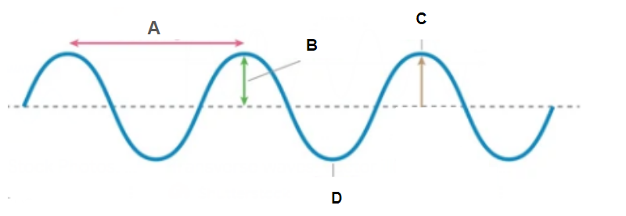

Transverse Waves
6.8C Explain how energy is transferred through transverse and longitudinal waves
Energy Source
Disturbances (like your hand moving up and down when you jump rope, the explosions in the sun creating heat and light that radiates to us, the wind blowing and making ocean waves, or earthquakes shaking the ground) create vibrations. The energy of these vibrations move up and down as they move away from the source or PERPENDICULAR to the direction the wave is traveling.
Direction of Vibrations
These vibrations move from the energy source to wherever they’re picked up. If it’s light, it may reach your eye or a photosensor in a camera or solar panel. If it’s heat, it may reach flowers on Earth’s surface. If it’s motion, it may eventually reach (like a wave on a rope or a seismic S-wave), it may eventually reach the end of the rope or a seismograph station on the other side of the planet!
Notes:
Wave created via https://ophysics.com/t3.html (free wave drawing tool & Google Slides)
Excellent explanations - https://youtu.be/wofUndFivZE?si=wsKGDLQX48WiZ34V
https://www.youtube.com/watch?v=4kFasbmY04c

Slide 19
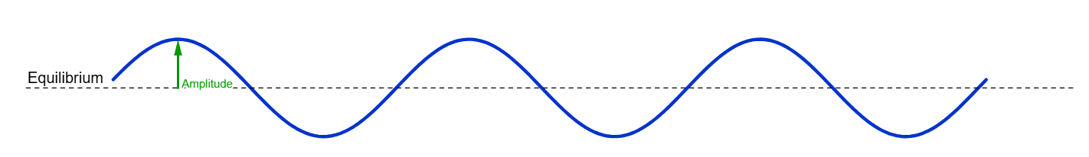
Transverse Waves
6.8C Explain how energy is transferred through transverse and longitudinal waves
Crest
Resting
Position or Equilibrium
Amplitude
Energy Source
Trough
Wave length

Slide 20
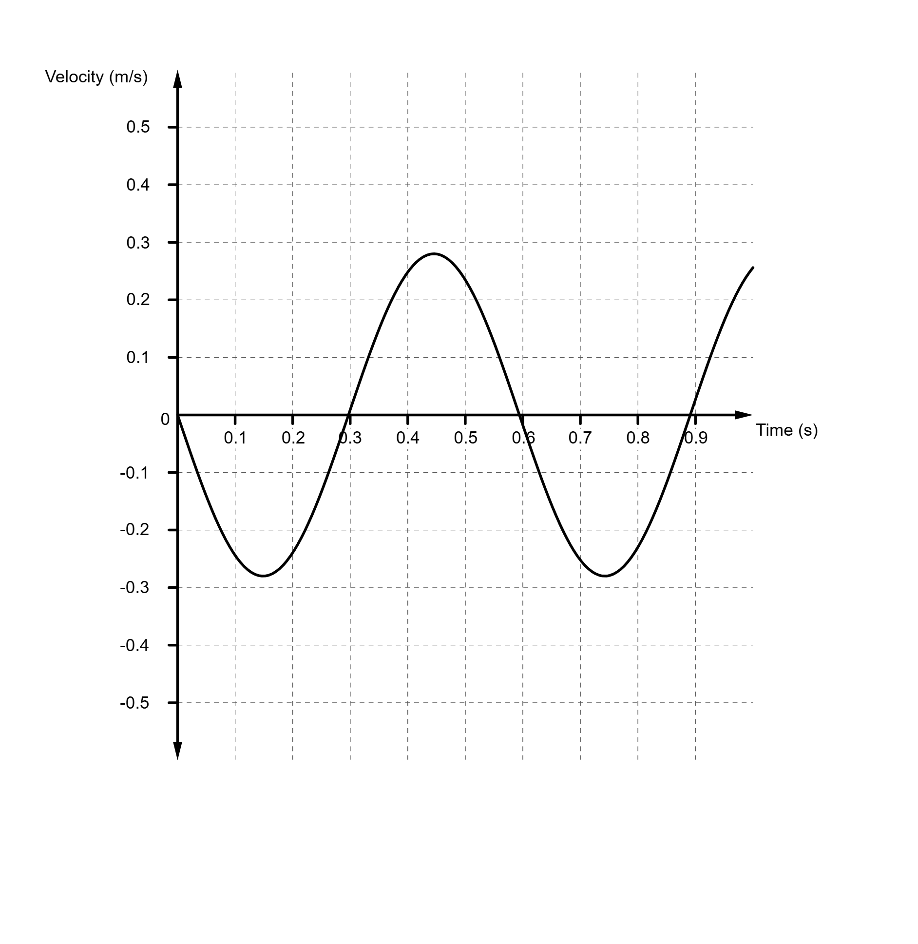
Transverse Waves
6.8C Explain how energy is transferred through transverse and longitudinal waves
Crest
Wave
Height
Amplitude
Rest position
Trough
Wavelength
Notes:
Wave created via https://ophysics.com/t3.html (free wave drawing tool & Google Slides)
Excellent explanation - https://youtu.be/wofUndFivZE?si=wsKGDLQX48WiZ34V

Slide 21

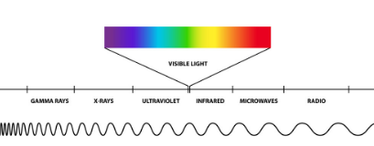
What’s in a Wave?
8.8A - Compare the characteristics of amplitude, frequency, and wavelength in transverse waves, including the electromagnetic spectrum.
Remember, they ALL travel at the speed of light, but the WAVE LENGTHS differ.
Imagine a pond. When you drop a pebble into it, ripples spread out across the water. These ripples are waves carrying energy from the point of origin to the edges. EM radiation is similar, but instead of water ripples, it’s made of waves of energy that travel through space - no medium required. These waves are created by the movement of particles, like electrons accelerating in a magnetic field or the vibrations of atoms.
Imagine the sun is a giant lightbulb, but instead of just one kind of light, it sends out a whole range of radiation. This radiation includes…
Radio waves, Microwaves, Infrared, Visible light, Ultraviolet, X-rays, and Gamma rays
Notice how the length of these waves VARY!
Notes:
TYPE of wave depends on its wavelength = longer or lower freq. = less energy
Shorter or more frequent = more energy
EM spectrum matching game on MissDoctorBailer.com
Images from Freepik.com and PhillipMartin clipart (free)
Video https://youtu.be/KWzyQKcJBYg?si=wQLJw_0ng0WuaQNc

Slide 22

What’s in a Wave?
How do these various wavelengths help us see different colors?
Those differences in wavelengths appear as different colors. We all learned ROY G BIV to describe the order of light in a rainbow or through a prism and they can see these prisms using spectroscopic glasses or lenses. I ask the students to draw the order they see when looking at different lights. Ask students which color has the HIGHEST energy and which has the lowest energy. (Show green, red and blue/violet lasers on wall or ceiling. - They often choose colors that seem “bright.” Show all against light sensitive or glow-in-the-dark cloth and they will see which has the greatest energy because it will “write” on the cloth. Its higher energy excites the electrons and takes longer for the pattern to decay.
ENERGY!
And each of these wavelengths have different uses here on Earth.
Notes:
Use spectroscopic glasses to see the various colors then use the lasers to discuss energy. Link to a lab I use with light here - https://docs.google.com/document/d/14U8kG1zLeTsvSjpHXqGurwjwSNnkyuoWjhqU80alj-4/edit?usp=sharing
https://docs.google.com/presentation/d/12l0nOsdwH-kvxC_CuINsdaeBM0eI3aj36COk-tu5SyY/edit?usp=sharing

Slide 23
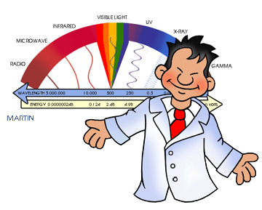
So what do we do with all that energy?
8.8B – Explain the use of electromagnetic waves in applications such as radiation therapy, wireless technologies, fiber optics, microwaves, ultraviolet sterilization, astronomical observations, and x-rays.
Radio Waves: These are the largest waves. We use them for broadcasting radio shows, TV programs, and even for cell phone signals. Where would you be without them?
Microwaves: These are the speedy chefs of the spectrum. They heat up our food in microwave ovens and help satellites communicate with Earth.
Infrared: These are the heat-seeking waves. You can't see them, but you can feel them as warmth. They're used in remote controls, night vision goggles, and even to study distant stars.
Visible Light: This is the part of the spectrum we can see with our eyes, from red to violet. It helps us see the world around us and enjoy beautiful colors.
Ultraviolet (UV) Light: These are the sun's rays that can give us a tan or a sunburn. They're also used to kill germs and sterilize medical equipment.
X-rays: These are the powerful waves that can pass through our bodies to create images of our bones and teeth. Doctors use them to diagnose illnesses.
Gamma Rays: These are the most energetic waves in the spectrum. They're used to treat cancer and sterilize food.
So, the electromagnetic spectrum is like a toolbox with different tools for different jobs. We use these waves to communicate, to explore the universe, and to improve our lives in countless ways!
Notes:
To demonstrate it you can download smartphone app to tune into different radio stations and show them the infrared button on a remote control.
EXCELLENT video on Generation Genius (free teacher account) that shows the following -
Radio waves - Small transistor radio can be placed under a metal cup/pencil holder and interfere with the signal
Microwaves - put peeps in a microwave and watch them expand
Remote control for infrared
UV Sunglasses or sun screen on UV beads in a bag
X-ray
Geiger counter with small amount of radiation

Slide 24
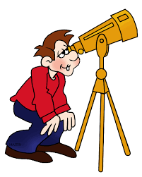
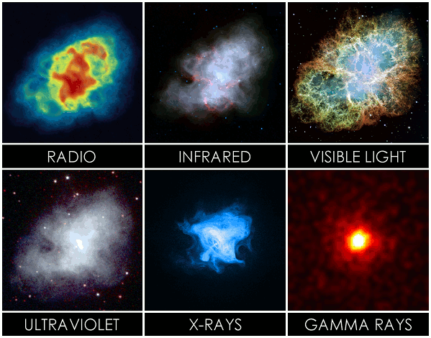
So what do we do with it?
8.8B – Explain the use of electromagnetic waves in applications such as radiation therapy, wireless technologies,
fiber optics, microwaves, ultraviolet sterilization, astronomical observations, and x-rays.
Many of these waves can also tell us so much more about our universe. Take a look at these images and see which one you'd rather study. Same place, different views!
Notes:
Missdoctorbailer.com EMSpectrum matching game
Guide to the Electromagnetic Spectrum in Astronomy | astrobites for image

Slide 25

So what do we do with it?
8.8B – Explain the use of electromagnetic waves in applications such as radiation therapy,
wireless technologies, fiber optics, microwaves, ultraviolet sterilization, astronomical observations, and x-rays.
Here are just a few careers that use these waves!
Electrical/Electronics Engineer Optical Engineer/Photonics
Radiologist / X-Ray Technician Medical Physicist
Astrophysicist Satellite/Aerospace Engineer
Acoustic Engineer Physicist
Seismologist (studying earthquakes) Non-Destructive Testing Technician
Geophysicist Audiologist
Sonographer / Ultrasound Technician Sonar Technician
Meteorologist Astronomer
Teacher / Physics Professor
Notes:
Missdoctorbailer.com EMSpectrum matching game
Guide to the Electromagnetic Spectrum in Astronomy | astrobites for image

Slide 26
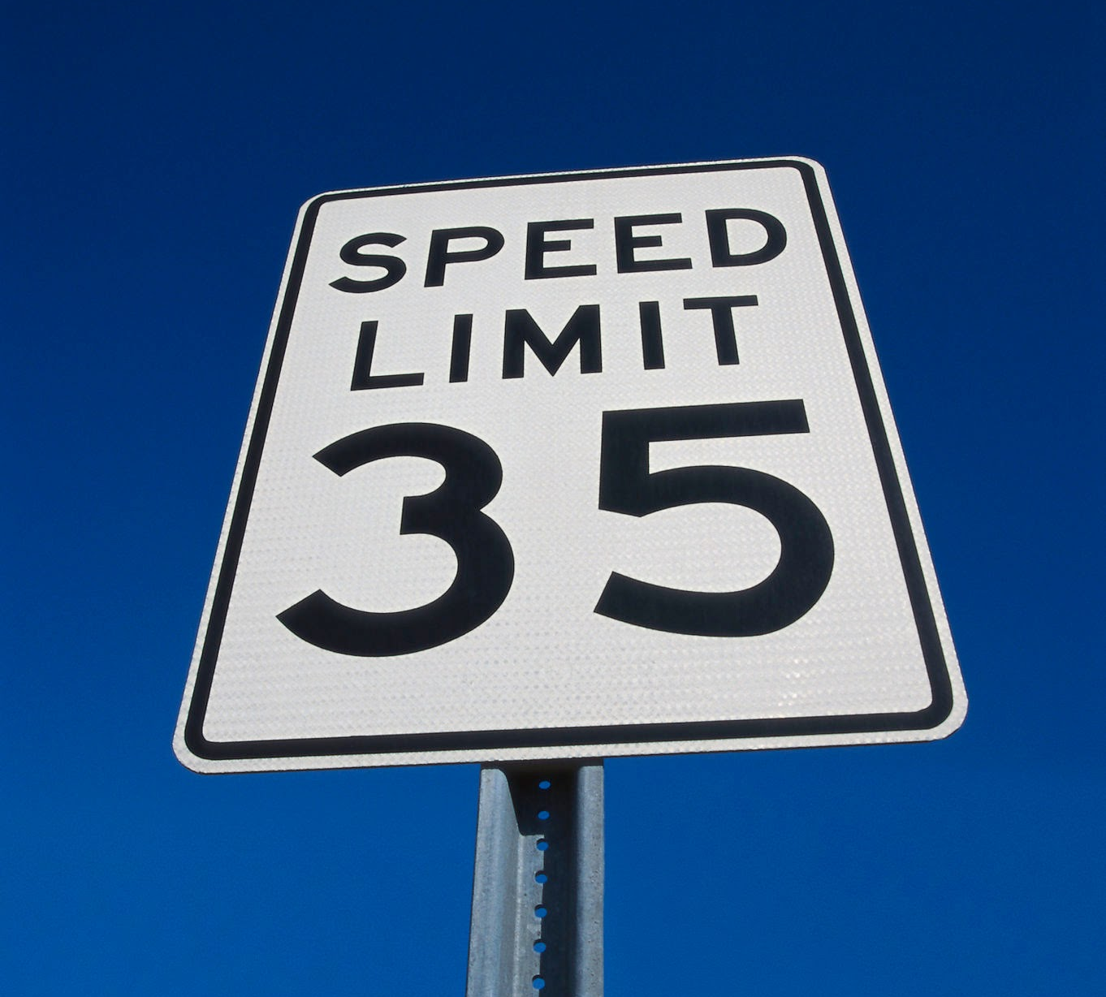
Commonly Confused…
What’s the difference between types and properties?
TYPES OF WAVES | PROPERTIES OF WAVES
2 MAIN TYPES – Mechanical vs. Electromagnetic Or – Longitudinal vs. Transverse | 4 PROPERTIES Amplitude Wavelength Frequency Speed
Students often confuse these and need to be able to differentiate.
To measure the SPEED of a wave, the formula is;
Speed of a wave (v) = Frequency (f) x Wavelength (λ) 1 Hz = 1 cycles or vibrations per second
So if a wave’s frequency is 10 cycles / second and its wavelength is 2 meters, its speed is 20 Hz

Slide 27
Collaboration
Drawings for freebies for your classroom
Any questions, comments, or suggestions?
Alternate ideas to teach these concepts?
Please don’t forget to place everything back into the pencil boxes before you leave.
THANK YOU FOR COMING!!!
Let’s shine the light on WAVES!

Slide 28
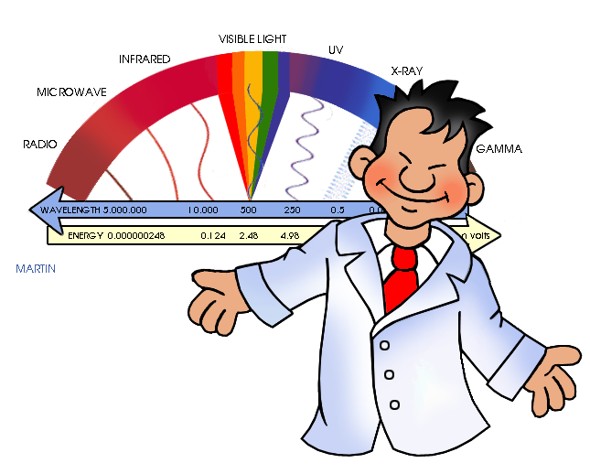
Thank you!
Julie Rhea, Bland ISD julie.rhea@blandisd.org
LINKS:
Free clipart from PhillipMartin http://a2z.phillipmartin.info/index.htm
EM Lab (matching game) from www.MissDoctorBailer.com
https://oPhysics.com/t3.html (can create free wave diagrams)
https://phet.Colorado.edu/sims/html/waves-intro/latest/waves-intro_all.html?authuser=0
https://docs.google.com/presentation/d/1en0P_5G1wsrmdkOHi5RMVMkMMr-nz53Lv37lLE4gUDI/edit?usp=sharing EM waves Venn Diagram – J. Rhea
Videos:
https://youtu.be/KWzyQKcJBYg?si+wQLJw_OngOWuaQNc
https://youtu.be/O0PawPSdk28?si=XGpN8aS5V4pGFXzb
https://youtu.be/_Okhe0tmGZY https://studyjams.scholastic.com/studyjams/jams/science/energy-light-sound/light.htm
Other:
https://dashboard.blooket.com/set/670ee2674213e2bfbef6645d (Blooket for 6-8th on waves)
https://docs.google.com/presentation/d/12l0nOsdwH-kvxC_CuINsdaeBM0eI3aj36COk-tu5SyY/edit?usp=sharing – various items in space using different wavelengths of the spectrum
https://docs.google.com/document/d/14U8kG1zLeTsvSjpHXqGurwjwSNnkyuoWjhqU80alj-4/edit?usp=sharing - the lab I use with that presentation
Guide to the Electromagnetic Spectrum in Astronomy | astrobites for image (no copyright infringement intended.)
Notes:
6-8 Blook - https://dashboard.blooket.com/set/670ee2674213e2bfbef6645d
8th grade Blook on waves - https://dashboard.blooket.com/set/671aa8142638356f348c8c18

Slide 29
Resources:
Amazon.com
GIRAFVINYL Glow in the Dark Printable Sticker Paper for Inkjet Printer - Printable Vinyl Sticker Paper White Vinyl Sheets - Waterproof Decal Paper - 10 Sheets, 8.5"x11“ = $12.99 for a pack of 10 OR
TransOurDream Heat Transfer Paper for Dark T Shirts (10 Sheets, 8.5x11'') GLOW IN THE DARK Iron on Transfers Paper Printable Heat Transfer Vinyl for Inkjet Printer = $16.99 for 10 sheets
Red Green Violet Pointer for Cats (3 Pack), Pet Light Toys for Kittens and Dogs, Indoor Training and Chaser Toys for Cats. = $14.99 for a set of 3
Spectroscopic glasses - Rob's Super Happy Fun Store Fireworks Diffraction Glasses - Rave Waves and Rainbow Spectrum Variety Pack = 25.99 for 50 or 100 for 49.99 (They have cheaper, but they usually have a pattern in the lens. I’d recommend shopping around.)
Milanix Small AM/FM Transistor Radio - Walmart 9.95 - Pen holder cup for desk 5.25 Polyester Outdoor Clothesline 2.53
Karlling Battery-operated LED Fairy Light String – 7.95 (light box I used 2 and an old printer paper box)
Educational Innovations - https://www.teachersource.com/
Plastic wave spring (single) Item # SPR-225 = $12.31
For the rosin - Educational Innovations Item # SNG-150 = 3.95
Prism Glasses (Double Axis) – pack of 10 for 8.95
Home Depot or Lowe’s - Aluminum rod 4.98 - 12.58
Walmart, Dollar General or Amazon.com - Slinky ~3.97- 5.00 per; Tonic Water .97

Slide 30

To learn more about the Electromagnetic Spectrum and some great STEM activities, sign up for NASA’s Liftoff Teacher Academy, online application at http://www.tsgc.utexas.edu/liftoff/

Slide 31
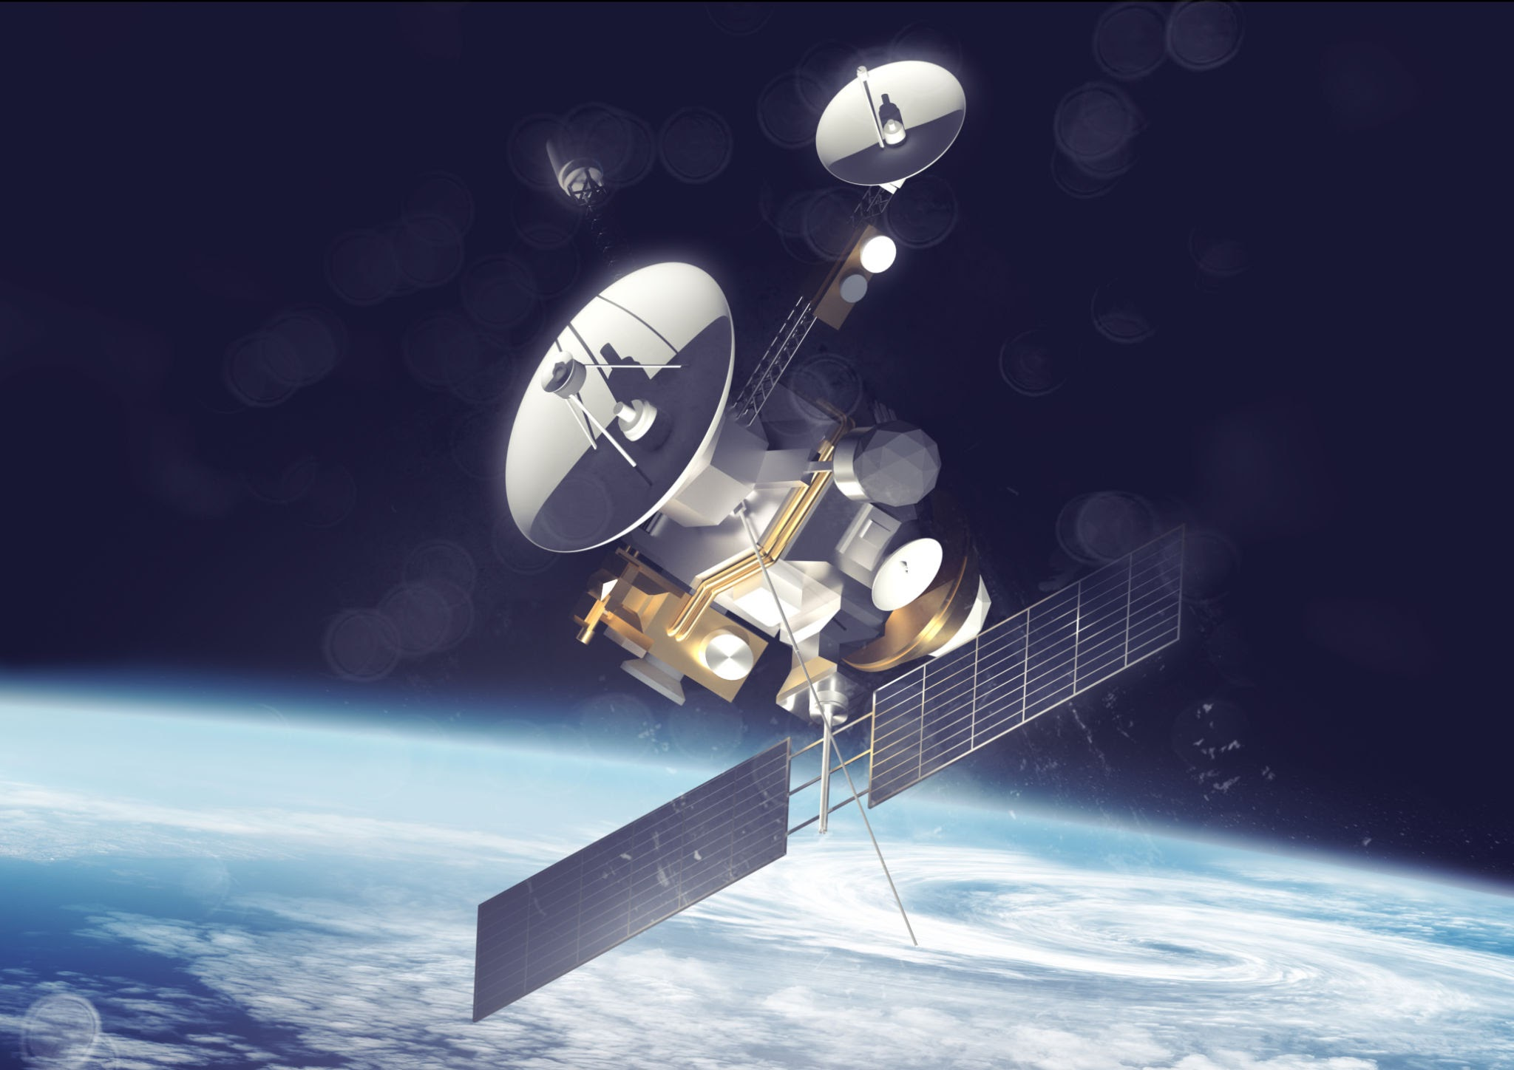

Thank you!
Julie Rhea, Bland ISD julie.rhea@blandisd.org
www.rheazclass.com
QR code for the handouts and foldables
Presentation
  This presentation may contain copyrighted materials used under the educational fair use exemption to the U.S. Copyright Law. Further use is prohibited.

