Slide 1



Longitudinal Waves Made Easy
Sound
These vibrations reach our ears and our brains translates them into SOUND. Some have frequencies too high or low for human hearing and depending on the frequency of the compressions, it can have higher or lower pitch. We measure sound in Hertz (Hz.) We call this end the transducer or receiver and it converts sound to electrical energy.
Energy Source
Sounds (like your voice, musical instruments, the P waves of an earthquake, etc.) create vibrations or ripples of energy moving out away from the source in a direction PARALLEL to the resting position of the particles in a medium - meaning the particles move back and forth in the same direction that the wave is traveling.
Direction of Vibrations
These vibrations move through the air causing pressure variations in particles of a medium (what it’s traveling THROUGH) as those particles are pushed in waves - these vibrations cause disturbances in the medium through which they’re traveling (air, water, or solids).
Test it out!
Notes:
Try to hear a gentle tap through solid (book), liquid (a bag of water), and gas (a balloon). Which one helps it travel best?

Slide 2

Longitudinal Waves Explained
Amplitude
(How close the coils are in their compression)
Rest position
(Where the coils are neither compressed nor rarefied)
Compression
Energy Source
Direction of the wave
Wavelength
(From compression to compression or rarefaction to rarefaction)
Rarefaction
or
Expansion
Amplitude in Longitudinal waves can be tricky to understand. Greater amplitude impacts the coils more resulting in more compression and greater rarefaction. The greater the compression, the more energy is being carried and the amplitude is the measure of that energy. Basically, the more it’s squished and released, the greater the energy on the move!

Slide 3
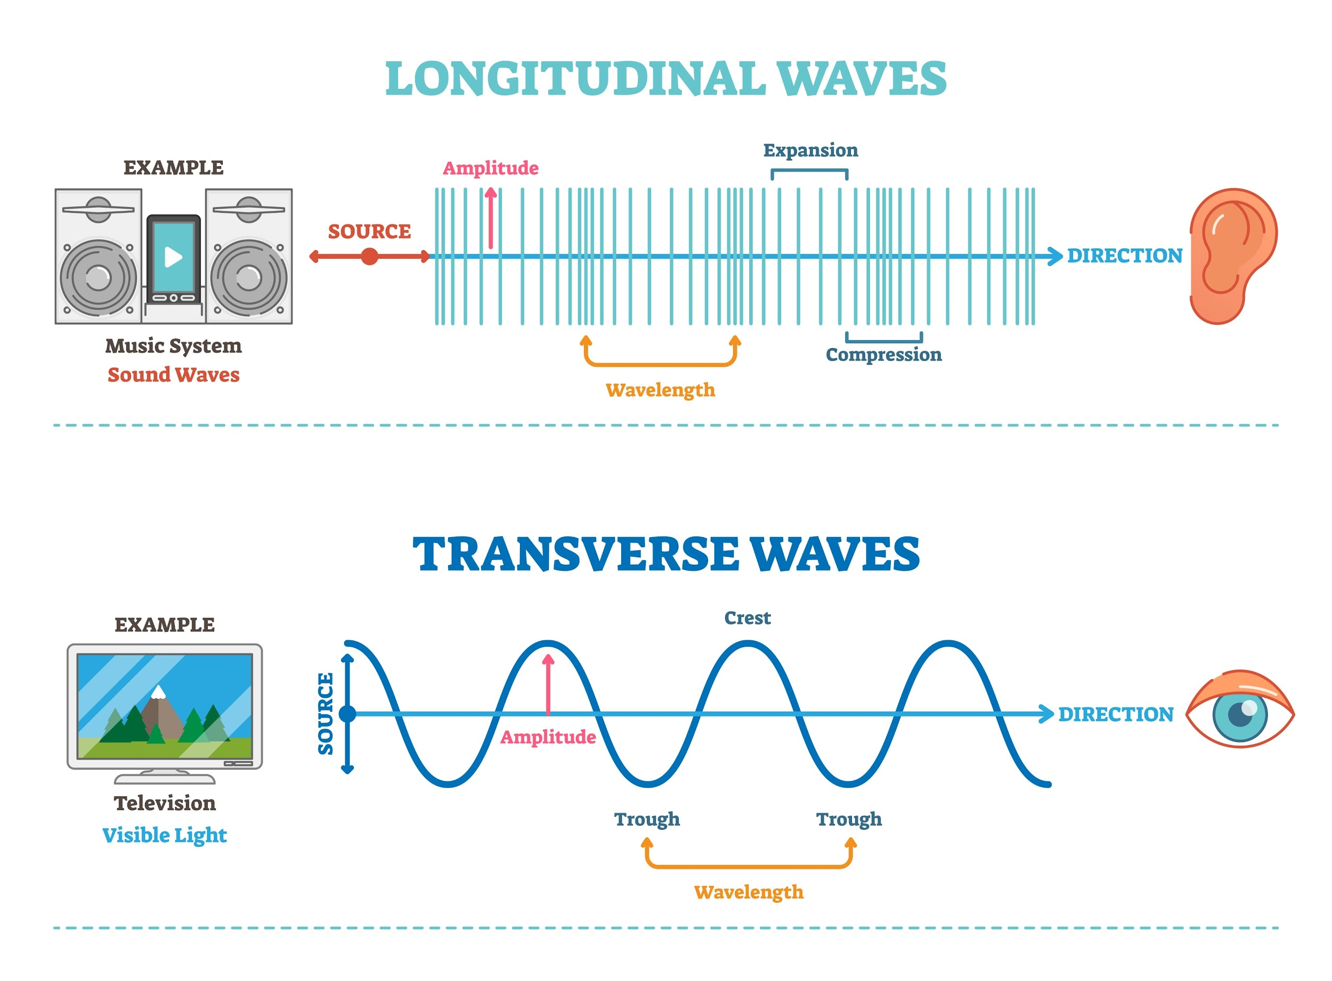

While a lot of slides will show amplitude of longitudinal waves as an arrow from the resting position to the top of the diagram, this is VERY misleading. It’s actually from line to line - the amount of compression that is the amplitude here - not the height of the lines. This is different from Transverse waves where amplitude IS the height of the crest or trough.
X

Slide 4
Longitudinal Wave
(with labels)
Amplitude
Compression
Rest position
Energy Source
Direction of the wave
Wavelength
Rarefaction
or
Expansion
Notes:
Wave created via https://ophysics.com/t3.html (free wave drawing tool & Google Slides)

Slide 5
Longitudinal Wave
_________________
_________________
_________________
____________________
Direction of the wave
_________________
_________________
Notes:
Wave created via https://ophysics.com/t3.html (free wave drawing tool & Google Slides)

Slide 6

Longitudinal Wave Foldable - Front
Longitudinal Wave Foldable
Amplitude
Compression
Resting Position
Energy
Source
Direction of the wave
Wavelength
Rarefaction
Notes:
Wave created via https://ophysics.com/t3.html (free wave drawing tool & Google Slides)

Slide 7
Longitudinal Wave Foldable - Inside
(Glue goes here)
Energy
Source
Compression
Wavelength
Rarefaction
Resting Position
Amplitude
Notes:
Wave created via https://ophysics.com/t3.html (free wave drawing tool & Google Slides)

Slide 8
Longitudinal Wave Foldable - Key
(KEY)
Please edit or change as needed
Energy
Source
Compression
Wavelength
Rarefaction
Resting Position
Amplitude
Sounds or vibrations create energy - ripples of movement - that travel parallel to the particles of the medium they’re moving through - like air, water, or solids.
The maximum distance a wave’s particles move away from the rest position in that medium.
(How much energy is there?)
Where the particles are squeezed closer together or compressed.
The distance between one compression and the next or one rarefaction and the next. It’s the length of one wave.
Where the particles of the medium are spread out or expanded.
Where the particles of the medium are when there is no disturbance or vibration to move through them.
Notes:
Wave created via https://ophysics.com/t3.html (free wave drawing tool & Google Slides)

Slide 9

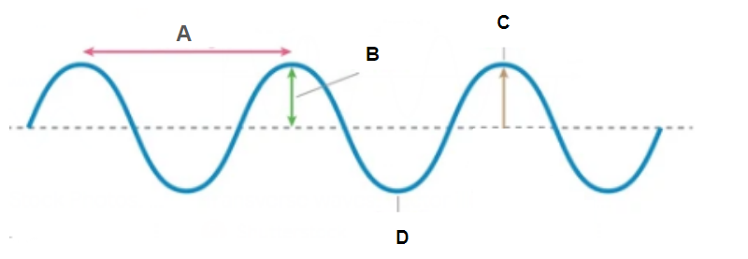

Transverse Waves
Made easier
Energy Source
Disturbances
(like your hand moving up and down when you jump rope, the explosions in the sun creating heat and light that radiates to us, the wind blowing and making ocean waves, or earthquakes shaking the ground) create vibrations. The energy of these vibrations move up and down as they move away from the source or PERPENDICULAR to the direction the wave is traveling.
Direction of Vibrations
These vibrations move from the energy source to wherever they’re picked up. If it’s light, it may reach your eye or a photosensor in a camera or solar panel. If it’s heat, it may reach flowers on Earth’s surface. If it’s motion, it may eventually reach (like a wave on a rope or a seismic S-wave), it may eventually reach the end of the rope or a seismograph station on the other side of the planet!
Notes:
Wave created via https://ophysics.com/t3.html (free wave drawing tool & Google Slides)
Excellent explanations - https://youtu.be/wofUndFivZE?si=wsKGDLQX48WiZ34V
https://www.youtube.com/watch?v=4kFasbmY04c

Slide 10
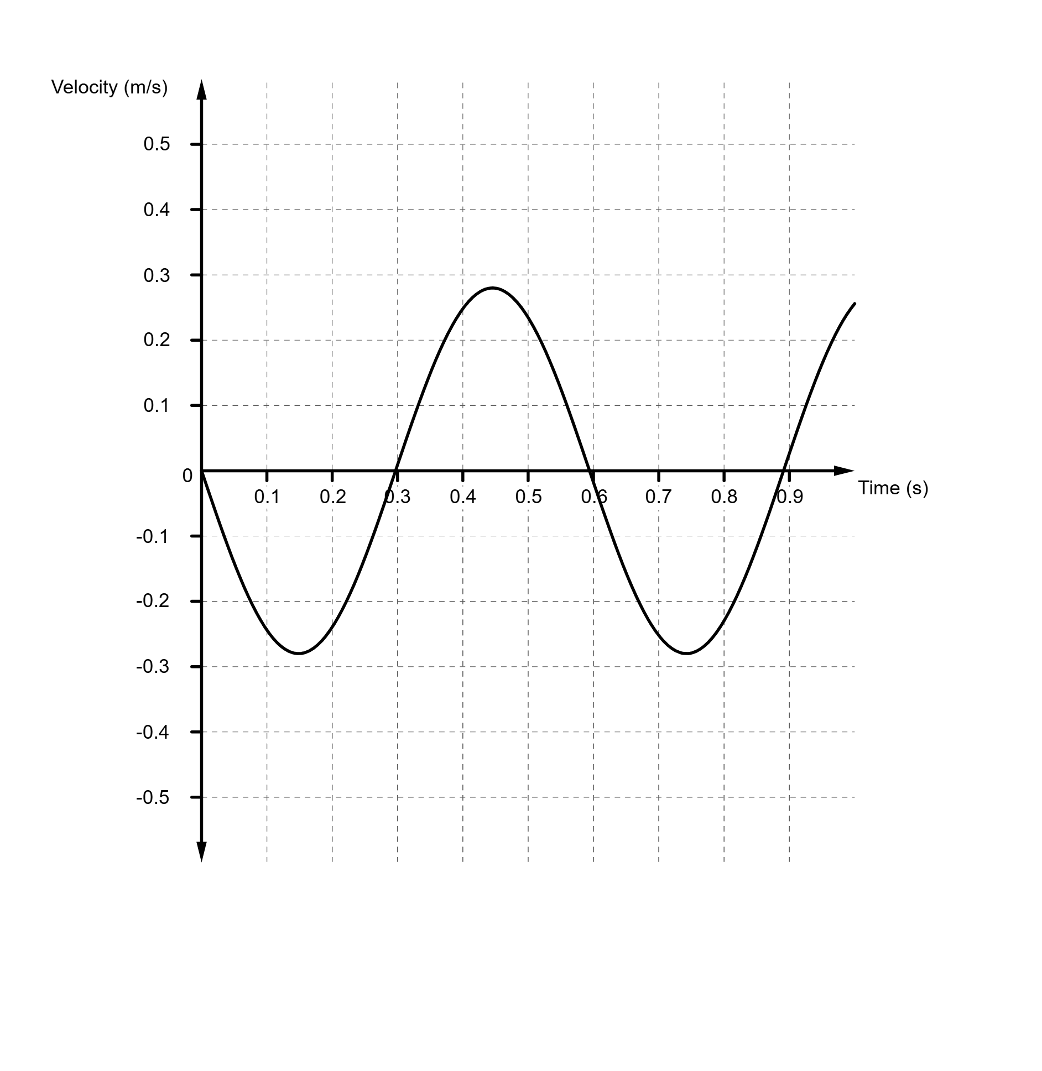
Transverse Wave
(labeled)
Crest
Wave
Height
Amplitude
Rest position
Trough
Wavelength
Notes:
Wave created via https://ophysics.com/t3.html (free wave drawing tool & Google Slides)
Excellent explanation - https://youtu.be/wofUndFivZE?si=wsKGDLQX48WiZ34V

Slide 11
Transverse Wave
(for notes)
____________
_______
_______
____________
____________
__________
__________ ________
Notes:
Wave created via https://ophysics.com/t3.html (free wave drawing tool & Google Slides)

Slide 12
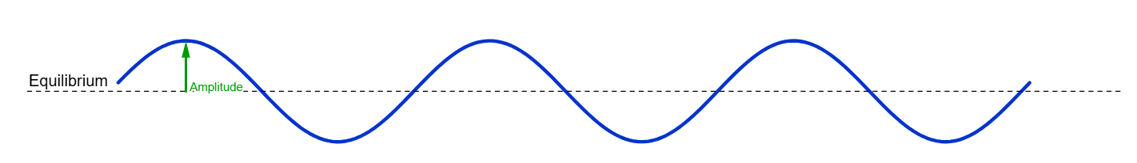
Transverse Wave Foldable - Front
Transverse Wave Foldable
Crest
Amplitude
Resting
Position
Energy Source
Trough
Wave length

Slide 13
Transverse Wave Foldable - Front
Transverse Wave Foldable
Crest
Amplitude
Resting
Position
Energy Source
Trough
Wave length

Slide 14
Transverse Wave Foldable - Inside
(Glue goes here)
Energy Source
Amplitude
Trough
Crest
Resting
Position
Wave length
Detector

Slide 15
Transverse Wave Foldable - Inside
(Glue goes here)
Energy Source
Amplitude
Trough
Crest
Resting
Position
Wave length

Slide 16
Transverse Wave Foldable - Key
(KEY)
Edit as needed for your class
Energy Source
Amplitude
Trough
OPTIONAL - Can add receiver or sensor in this spot if you prefer. (Longitudinal would be transducer or detector)
Definition:
Absorbs the wave’s energy and converts it to a measurable form like heat, light, electrical signals or vibrations. (Longitudinal = measurable form like sound, voltage or current, etc.)
Crest
Resting
Position
Wave length
The maximum distance a wave’s particles between the rest position and the peak or valley of that wave.
(How much energy is there? - the more distance the more energy.)
Physical disturbances create vibrations. The energy of these vibratrions move up and down perpendicular to the direction the wave is traveling.
Where the medium’s particle displacement is at its maximum or greatest. (The highest part of the hill.)
Where the particles of the medium are when there is no disturbance or vibration to move through them.
The distance between two identical and consecutive parts of a wave (crest to crest or trough to trough) It’s the length of one wave.
Where the medium’s particle displacement is at its minimum. (The lowest point of the valley.)

